Slide 1
PowerApps & Microsoft Flow
Senaj Lelic
Trainer
WW Education

Slide 2
Agenda
PowerApps
Customer Stories (lecture only)
Q & A
Microsoft Flow
Citizen Development
Common Data Service

Slide 3

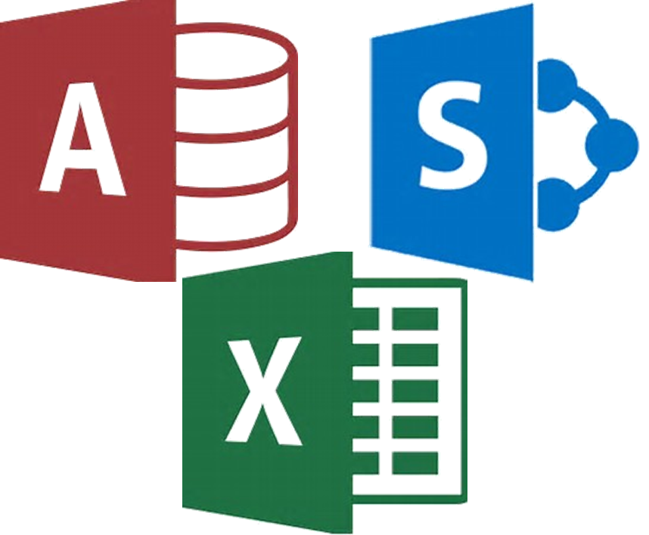
ü
Quick on-target MVP
û
Data quality and security
What happens when there isn’t an app like that?
û
Scale, Mobility
û
Maintainable
Business Users
Productivity Apps
OR
û
Quick on-target MVP
ü
Data quality and security
ü
Scale, Mobility
û
Maintainable
Business Users
Requirements
Pro Dev

Slide 4
Challenges using traditional coding
Source: 209 North American enterprises implementing low code platforms - Forrester study, June 2017

Slide 5
Primary Motivations on Non-IT Developers
Source: Unisphere Research study, Nov. 2017
Notes:
The Developement and Raise of the Citizen Developer is based on two major themse:
Disstatisfaction with current Service: we can do it better – we know the processes
New Potential surfacing

Slide 6
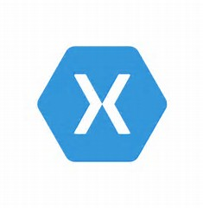



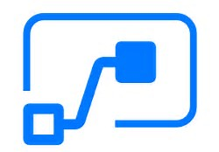
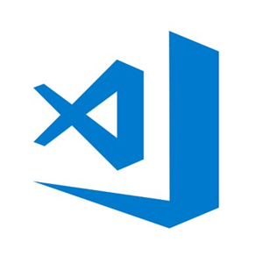

Microsoft
World class tools whatever your requirements demands
Citizen Developer
Professional Developer
Visual Studio
Visual Studio for Mac
Visual Studio Tools for Xamarin
Visual Studio
App Center
PowerApps
Flow
Power BI
Visual Studio Code
Visual Studio Team Services
ü
Productivity
Consistency
ü
Innovation
Flexibility
ü
ü

Slide 7
Profile: Who are Citizen Developers?
Source: Unisphere Research study, Nov. 2017

Slide 8
Types of applications developed outside IT departments/IT Service
Source: Unisphere Research study, Nov. 2017

Slide 9
Business application platform
MEASURE
ACT
AUTOMATE
Power BI
PowerApps
Microsoft Flow
Common Data Service

Slide 10
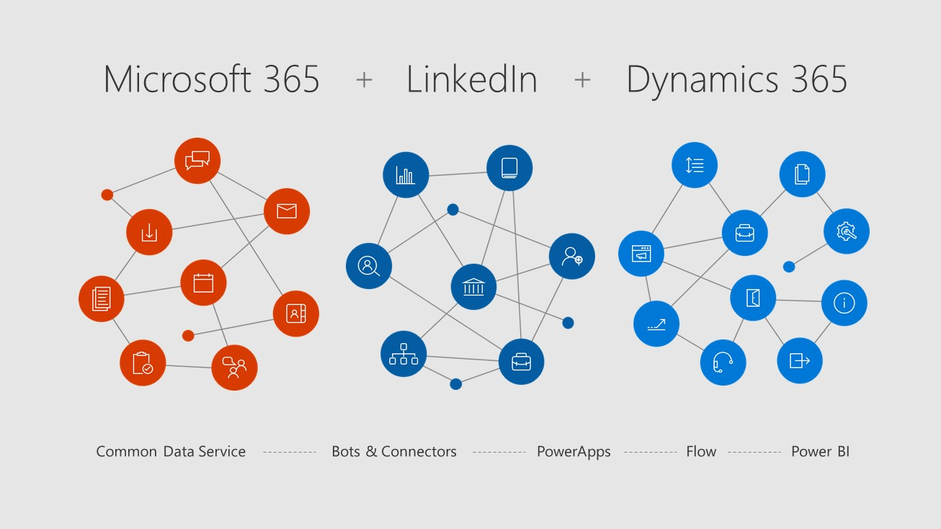


Slide 11
Business Application Platform
Power BI
PowerApps
Microsoft Flow
Common Data Service
Connectors + gateways

Slide 12

PowerApps
Business Application Platform
Power BI
PowerApps
Microsoft Flow
Common Data Service
Connectors + gateways

Slide 13
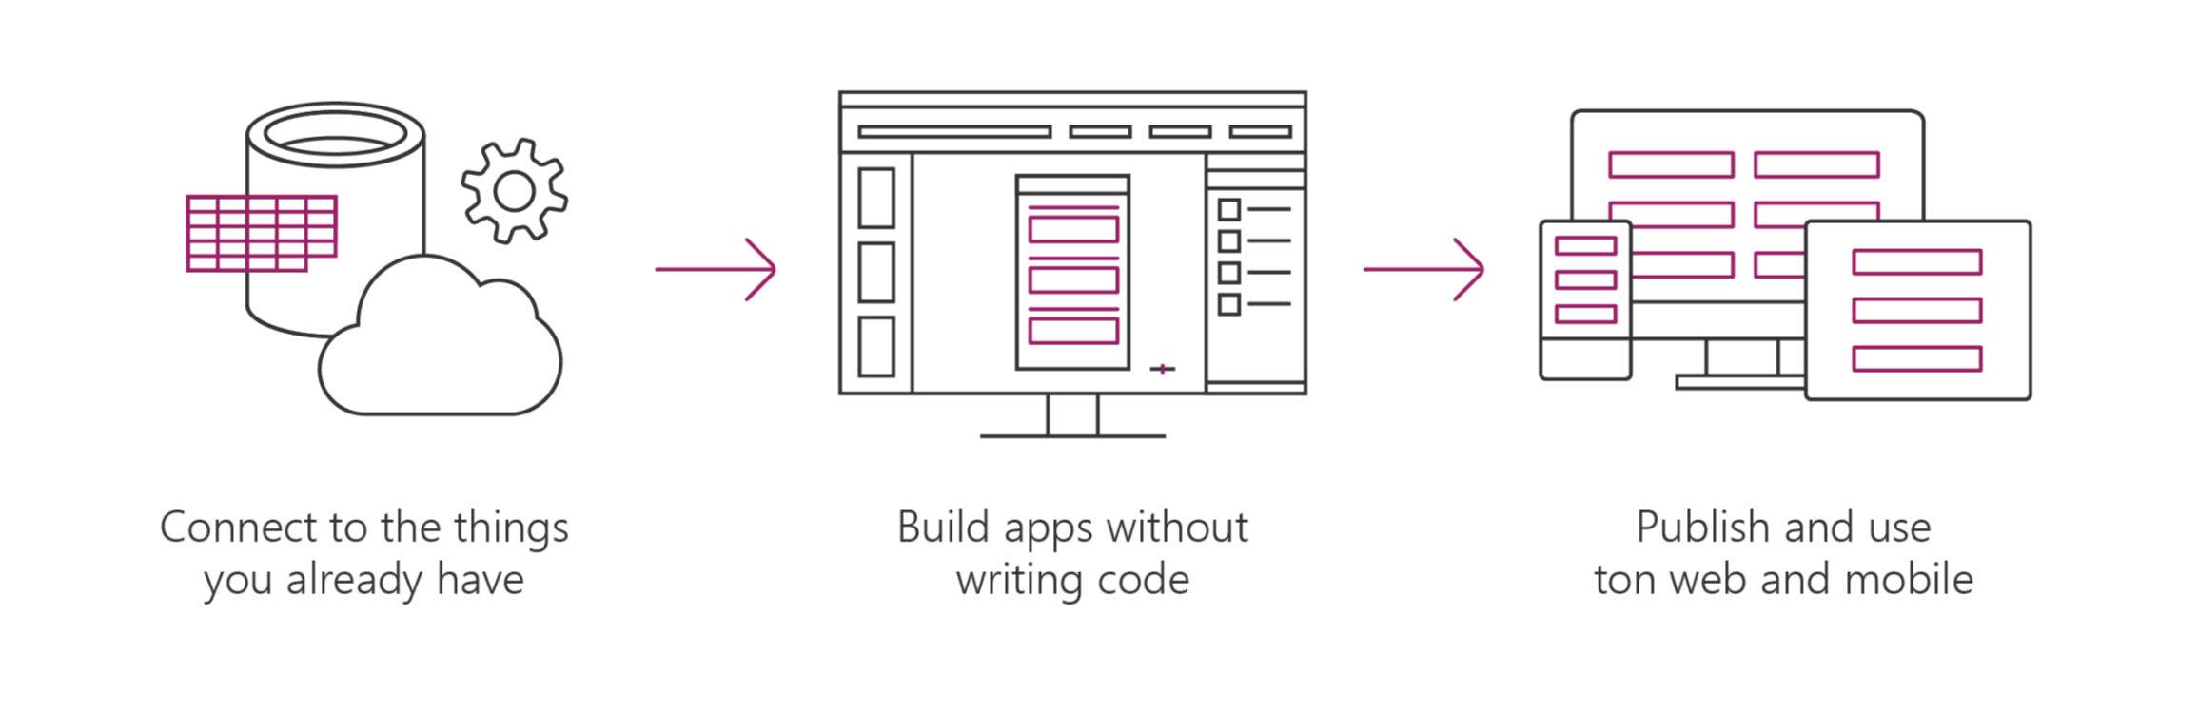
Microsoft PowerApps helps business-power-users to create and use custom business apps across platforms
Connect to data & systems you’re already using; create the data you need
Create apps, forms, and workflows without writing code
Use apps on web and mobile

Slide 14

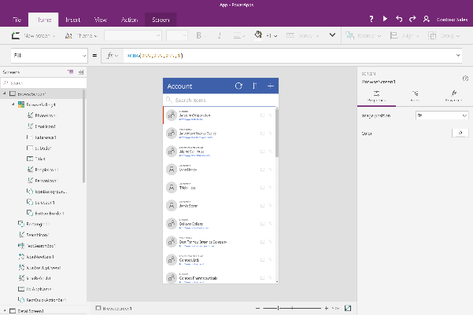
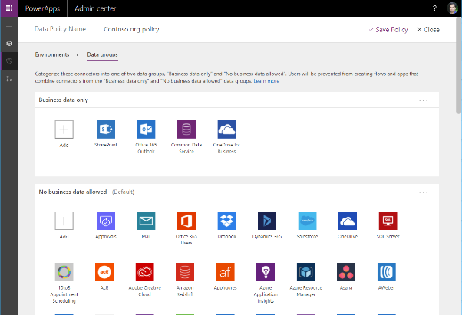
Easy Authoring
Truly WYSIWYG – full control over user experience, use it as you build it
Create app logic with familiar Excel-like expressions
Mash up data from multiple sources right at the app level

Slide 15
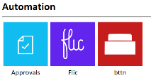
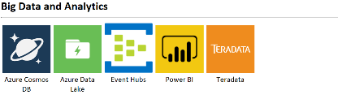
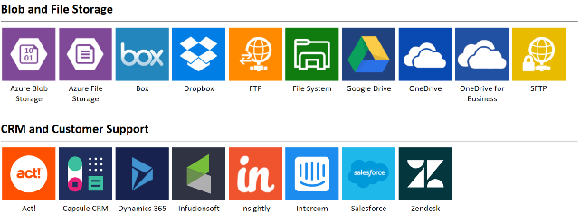
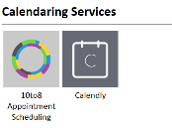
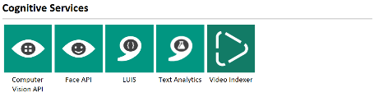
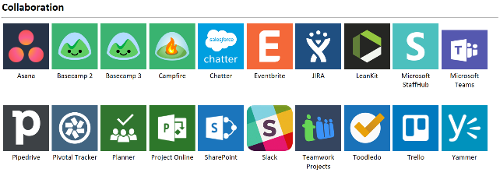
Connected data
Common data service provides a rich platform + standard model that gets creators instantly productive
Add 160+ connected data sources
Add custom connectors and on-premises sources

Slide 16
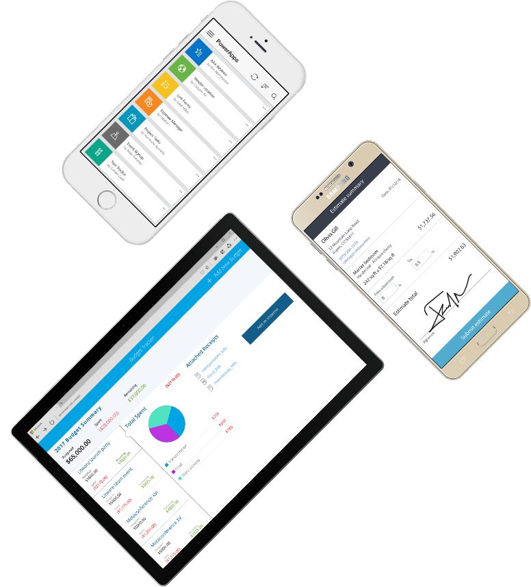
Cross-platform
Publish instantly to iOS, Android, Windows, and the web
Sharing apps is like sharing documents
Manage across environments

Slide 17

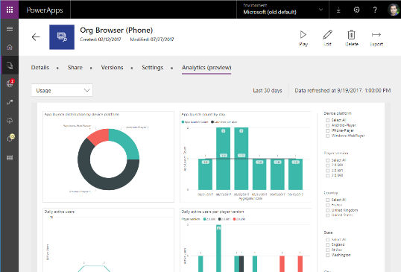


Enterprise Ready
Centrally view app telemetry and manage apps
Set DLP policy on data and connectors
Compliance with 13+ standards inc. HIPAA, EU Model Clauses & SOC

Slide 18

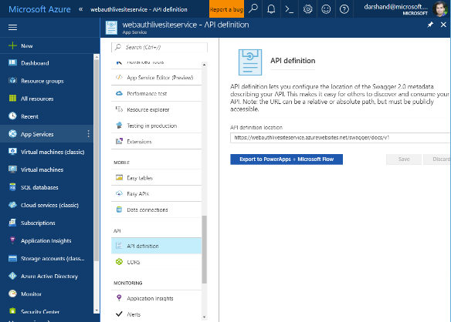

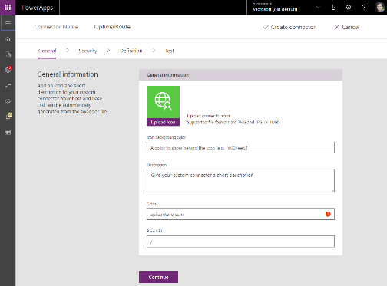
Pro developers welcome…
Build apps that go beyond what you get in the box
Build reusable custom app components & connectors
Leverage the full power of Azure capabilities

Slide 19

Microsoft Flow
Business Application Platform
Power BI
PowerApps
Microsoft Flow
Common Data Service
Connectors + gateways

Slide 20

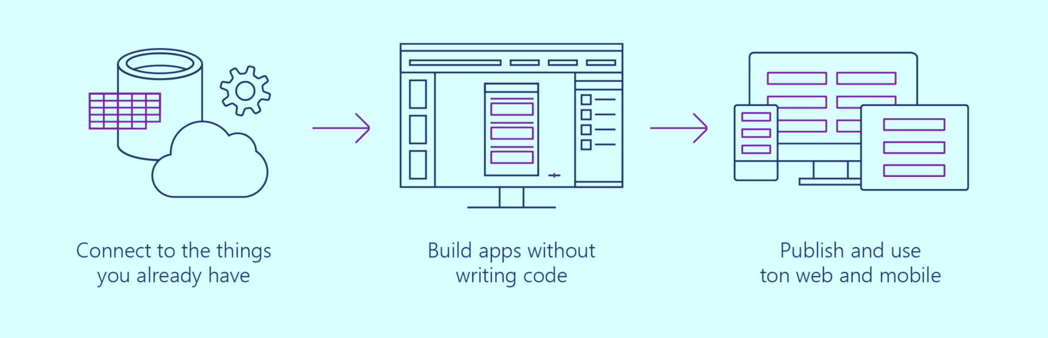
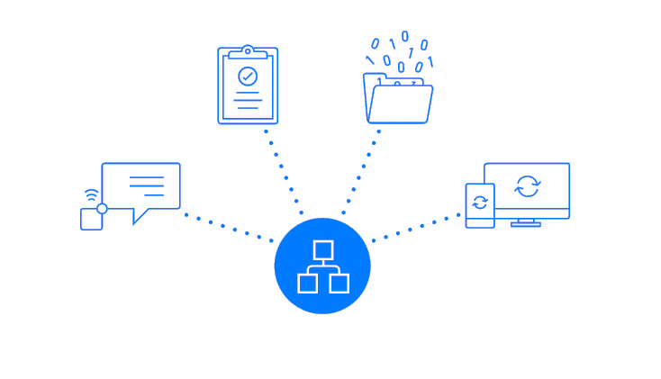

Microsoft Flow is a service for automating workflows
across apps and services
Connect to data & systems you’re already using; create the data you need
Create workflows using triggers & actions without code or scripts
Edit flows on web and mobile
Approve requests or manage them on web and mobile
Notes:
Microsoft Flow is a SaaS services that helps you work smarter by automating workflow across you’re a growing number apps and services that business users rely on.
The possible workflows span across a wide variety of possibilities, for example :
Get a notifications when a certain file is updated
Synchronize files by connecting your folders to keep data current,
Automatically collect and organize your business data
Streamline approvals and get instant alerts.
Microsoft Flow makes it possible to automate all of these scenarios and more.

Slide 21
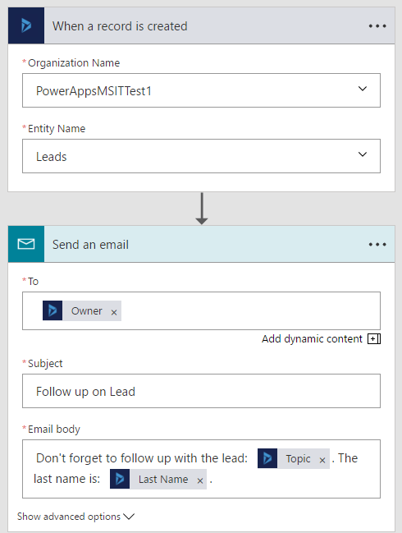
What makes up a Flow?
Example: Notification Flow
Trigger–the event that kicks off the flow:
Manually
On a schedule
On an event in the cloud
Actions–what the flow does
Uses data from the trigger

Slide 22
Microsoft Flow Mobile & Devices
Work less and do more, from anywhere
Adi to add content
Create new flows
Grant approvals
Get push notifications
Monitor flow activity
Discover buttons
Use button widgets
Create, run, and manage automated workflows between your favorite apps and services – even when you're on the go!

Slide 23
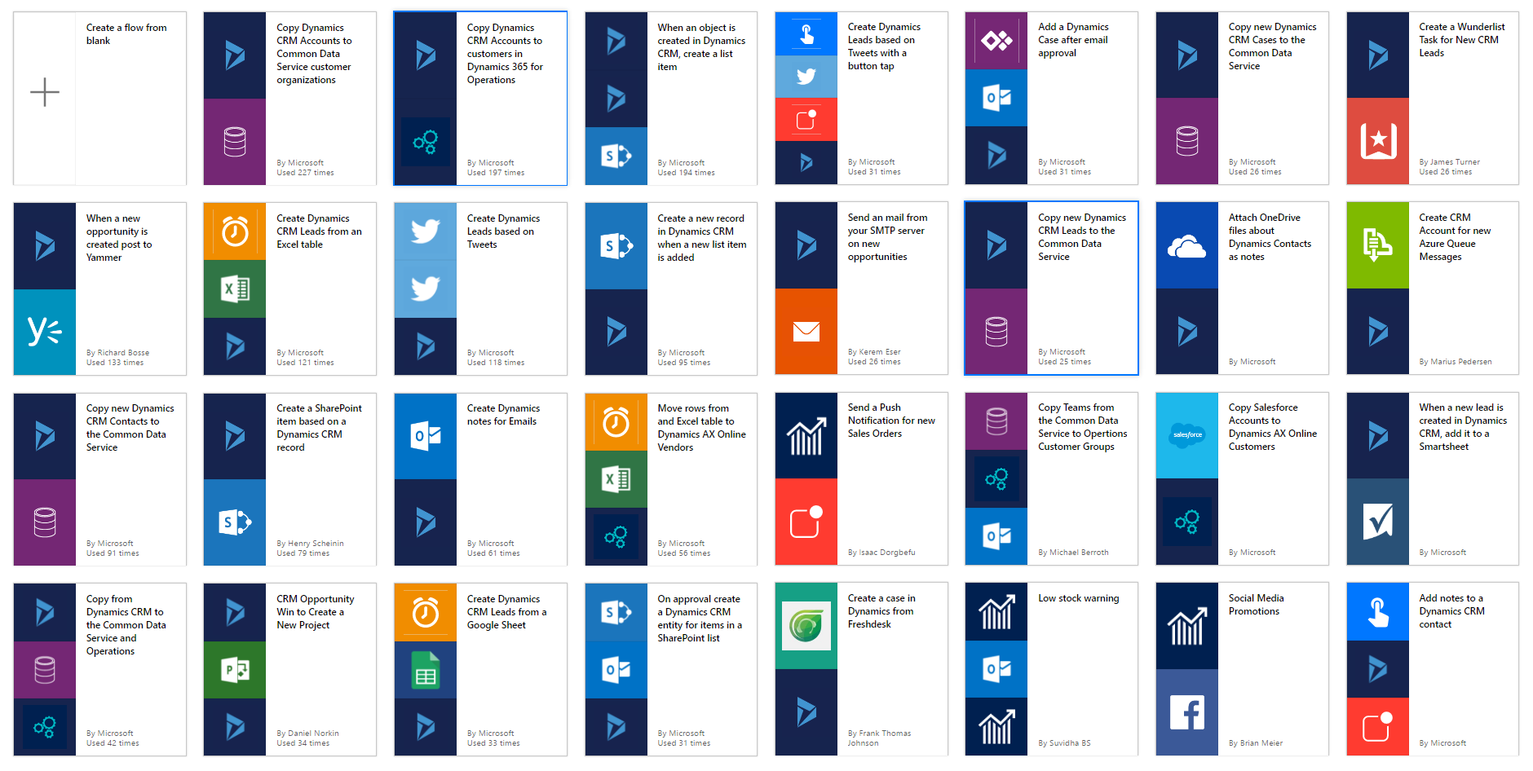
Templates help users to get started with Flow

Slide 24
Common Data Service
Business Application Platform
Power BI
PowerApps
Microsoft Flow
Common Data Service
Connectors + gateways

Slide 25


Power up your apps
Apps are most useful when they drive action based on complete and correct end-to-end views of data from across systems
Most companies struggle to do this today
Deploy expensive or home-grown solutions
Problems:
Stale data
Incomplete data
Insecure data
HR
Finance
(reporting)
Travel

Slide 26


The Common Data Service
CDS brings together your data from Dynamics 365, Office 365, and Azure Active Directory into one place.
We do the heavy lifting so you can focus on what matters:
discovering insights
building apps for action
automating processes
Your app here
Dynamics 365 Operations
Other Apps
Dynamics 365
Customer Engagement
Azure AD
Office 365

Slide 27

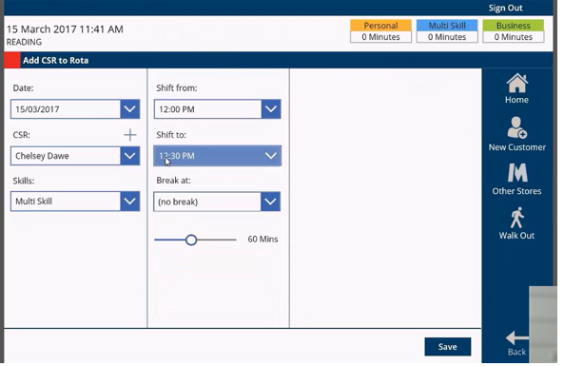

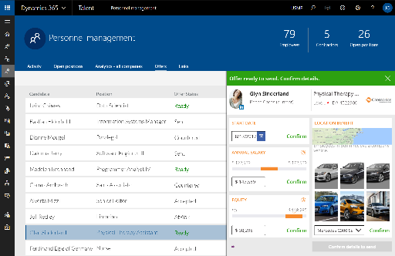
Extending Dynamics 365 with PowerApps & Flow
Build visually rich role and task specific apps
Extend the capability of Dynamics 365 apps across multiple data sources
Integrate 160+ apps and services into your business processes
Notes:
PowerApps and Microsoft Flow enable richer extensible scenarios for Dynamics 365 customers
It enables users other than central IT admins to build visual, role and tasks specific applications
Extends the capabilities for D365 and allows you to build apps across multiple data sources, easily combining the Dynamics 365 data with other sources
Integrate Dynamics 365 events with 160+ Apps and service to enable build more sophisticated workflows

Slide 28


Dynamics 365 extensibility
Advanced customizations PRO-DEV EXTENSIONS
Pro Dev
Role & Task Specific Apps
INTEGRATIONS; LAST MILE DIGITAL EXPERIENCES
3rd Party Solutions
APPSOURCE; REDUCE TIME TO VALUE
Power User
Dynamics 365 Apps
OUT-OF-BOX; CONFIGURABLE; CUSTOMIZABLE
Connected Data

Slide 29

We have over 1M+
monthly active users
People in over 213k+
organizations are using PowerApps and Flow
Notes:
And that’s not just theory – thousands of makers and even more users are taking advantage of the platform today.
We currently have over 1M+ Monthly active users for PowerApps and Flow and over 213K organization that are using PowerApps and Flow in less then one year!
Clearly these services fulling an unmet need!

Slide 30









We have over 1M+
monthly active users
People in over 213k+
organizations are using PowerApps and Flow
Notes:
Customers around the world are address problems from simple to advanced. From simple timesheet and survey applications advanced application managing car bidding process in car auctions

Slide 31
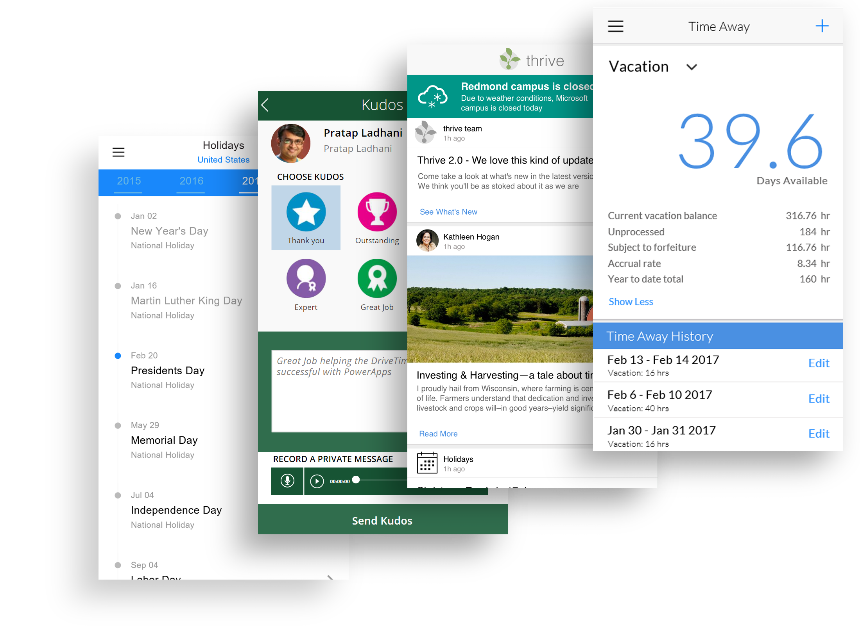
Internal: Microsoft HR Apps
Notes:
Mehdi: Add list of Apps with icons

Slide 32

PowerApps customer success story
METRO BANK

Slide 33
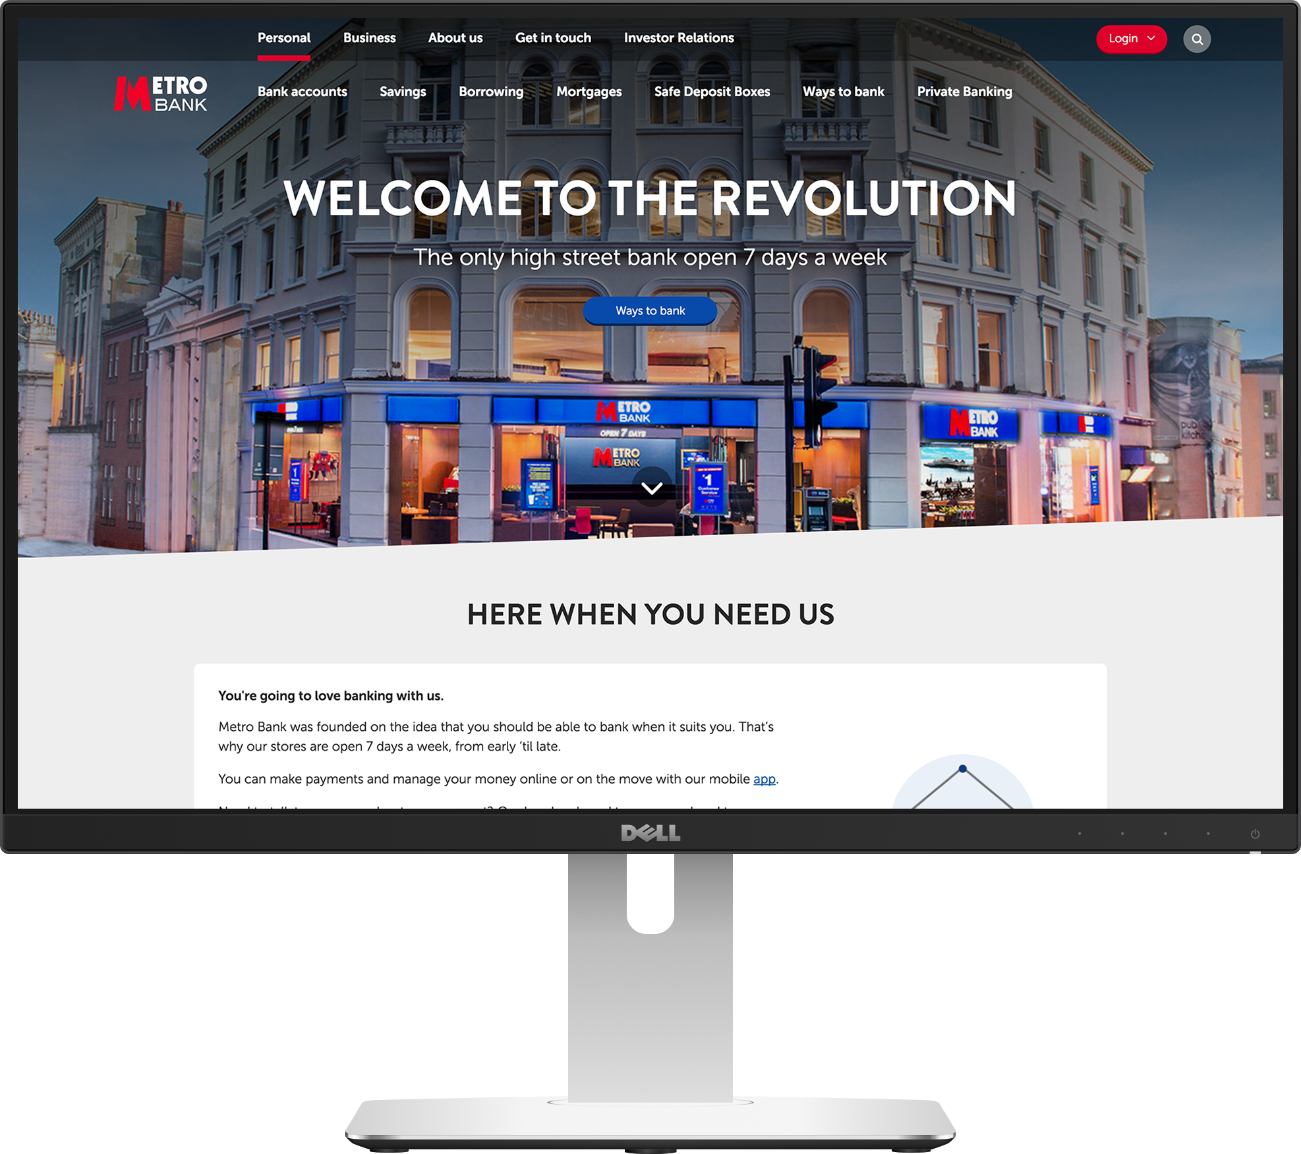

COMPANY BACKGROUND
Metro Bank
Metro Bank is a United Kingdom bank launched in 2010 as the first new high street bank in over 100 years. Metro bank specializes in personal customer service treating their branches like high end retail stores and staying open 7 days a week – 362 days a year.

Slide 34
BEFORE POWERAPPS
Metro Bank
Prior to PowerApps, a Metro Bank employee would greet customers with a clipboard. Then he would walk back to his desk and pull up the customer’s information on their computer by directly interacting with the CRM system. For a bank that prides itself at its technology focus, they did not have a technology solution at the first touch point of the their customer interaction.

Slide 35
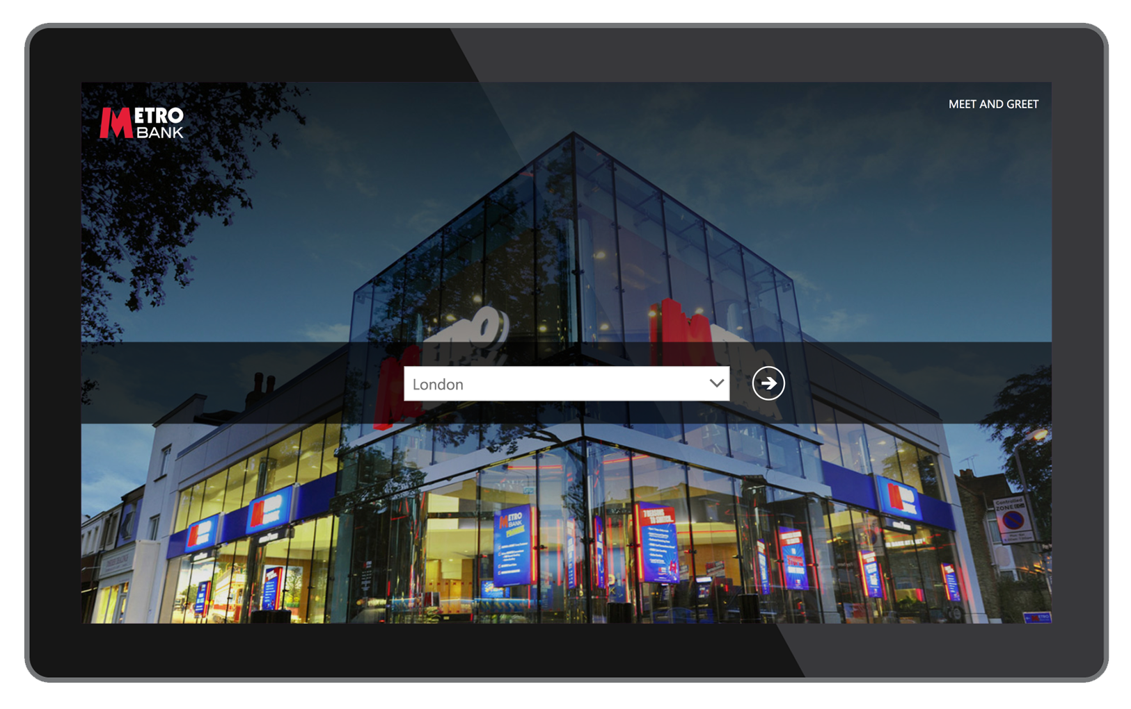
AFTER POWERAPPS
Metro Bank
With the help of PowerApps, Metro Bank employees now greet customers as they enter with a Surface tablet. They can now quickly pull up customer information, which speeds up customer service and improves the in-store customer experience. The app has led to an increase in Metro Bank’s NPS score around in-store customer experience.

Slide 36
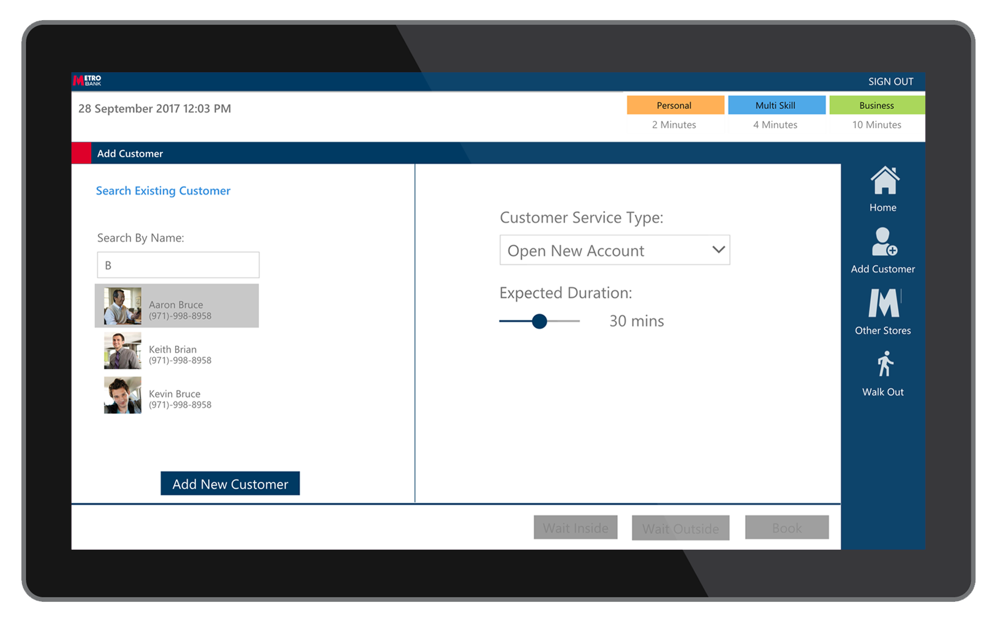
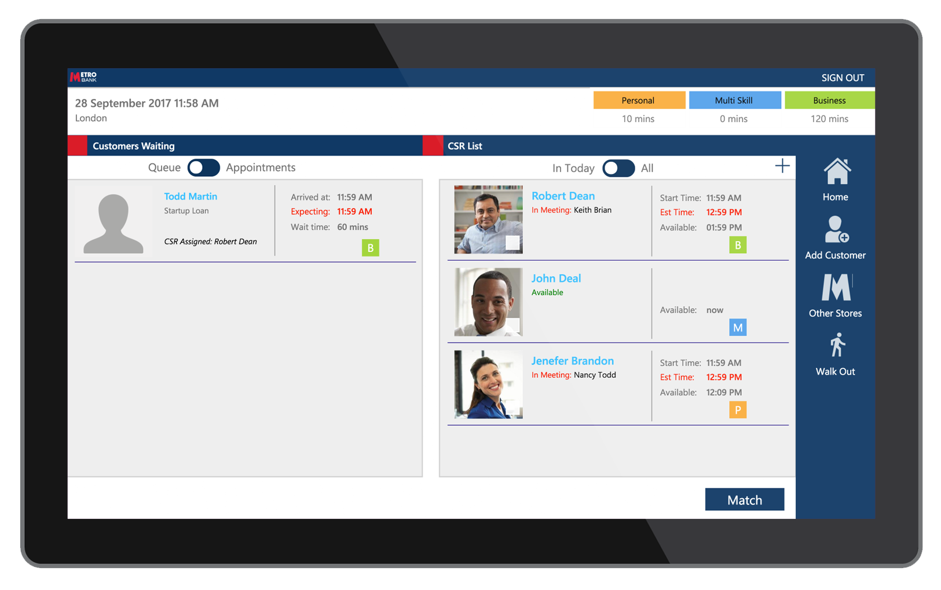
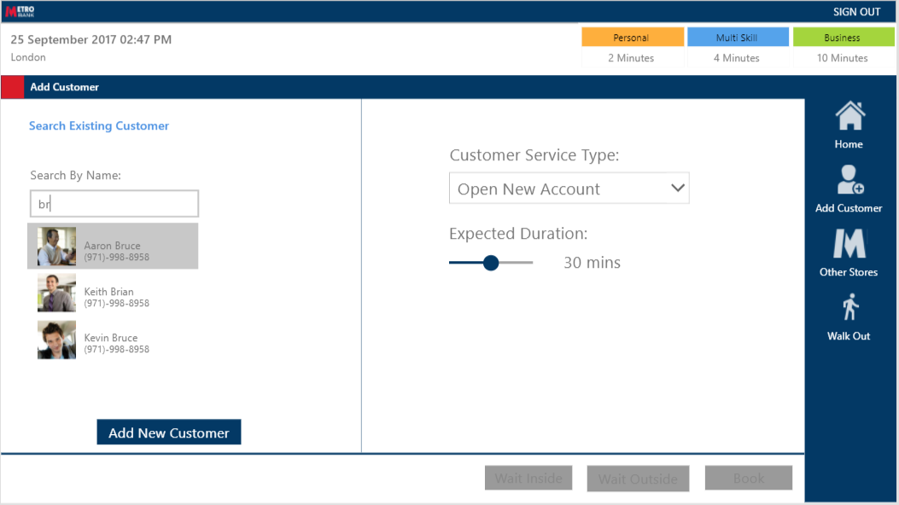
POWERAPPS SOLUTION
Metro Bank
Bring up customer information and assign customers to appropriate tellers based on availability. Provide estimated wait times and allow customer to choose to be notified by text or call.

Slide 37
CUSTOMER QUOTES
Metro Bank
"The ability to build an app within the space of a few days or few weeks is just fantastic" "We're a startup and we need all the help we can get and actually without Microsoft, we wouldn't be anywhere near where we wanted to be from a technology standpoint…it's been a great experience." -- Bruce Rioch, Chief Data Officer, Metro Bank (UK)

Slide 38

PowerApps customer success story
NATIONAL TRUST

Slide 39
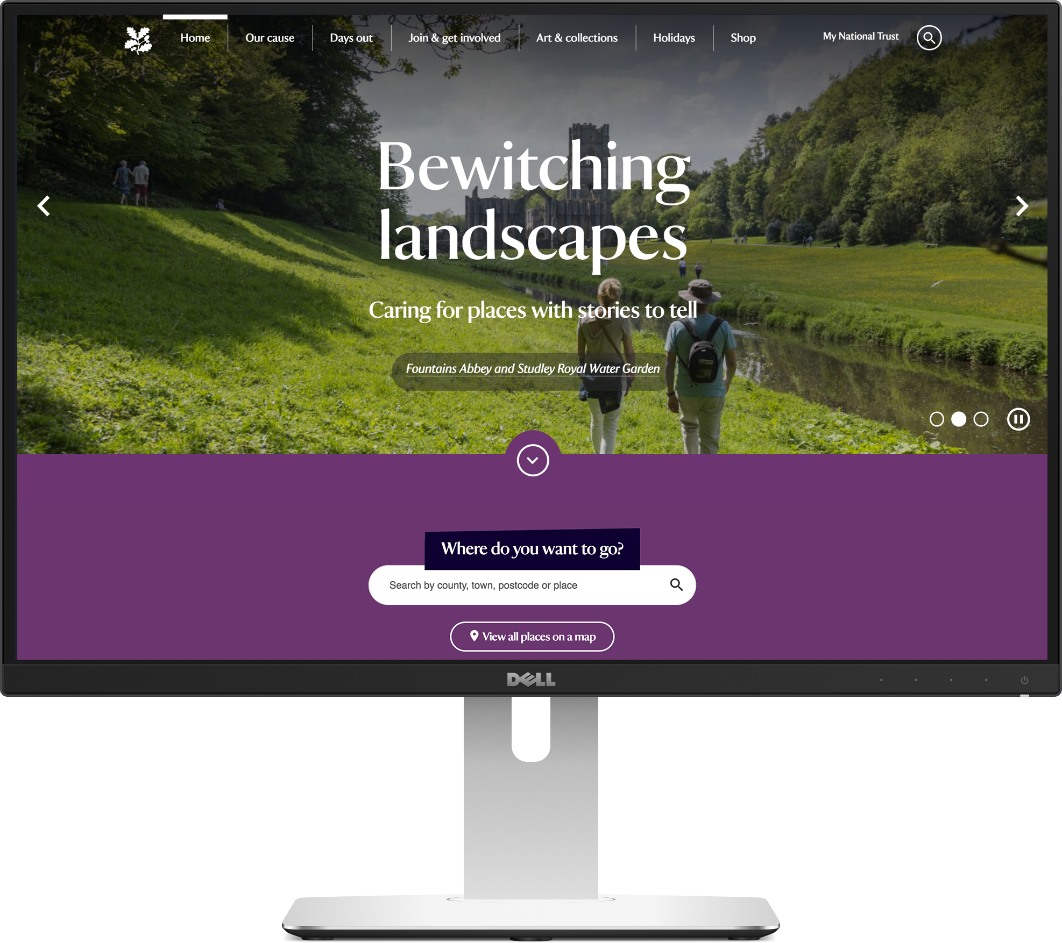
COMPANY BACKGROUND
National Trust
National Trust is a charity aimed at preserving United Kingdom’s heritage and open spaces. They have over 4.5 million members and 62,000 volunteers. They maintain 350 properties with 120 million yearly visits.

Slide 40

BEFORE POWERAPPS
National Trust
Prior to PowerApps, National Trust used a web page to inspect heritage properties. The site got limited usage use to usability issues. Most volunteers chose to take notes on paper and mail in the results. This made it difficult to collate the data and run business analytics over it.

Slide 41
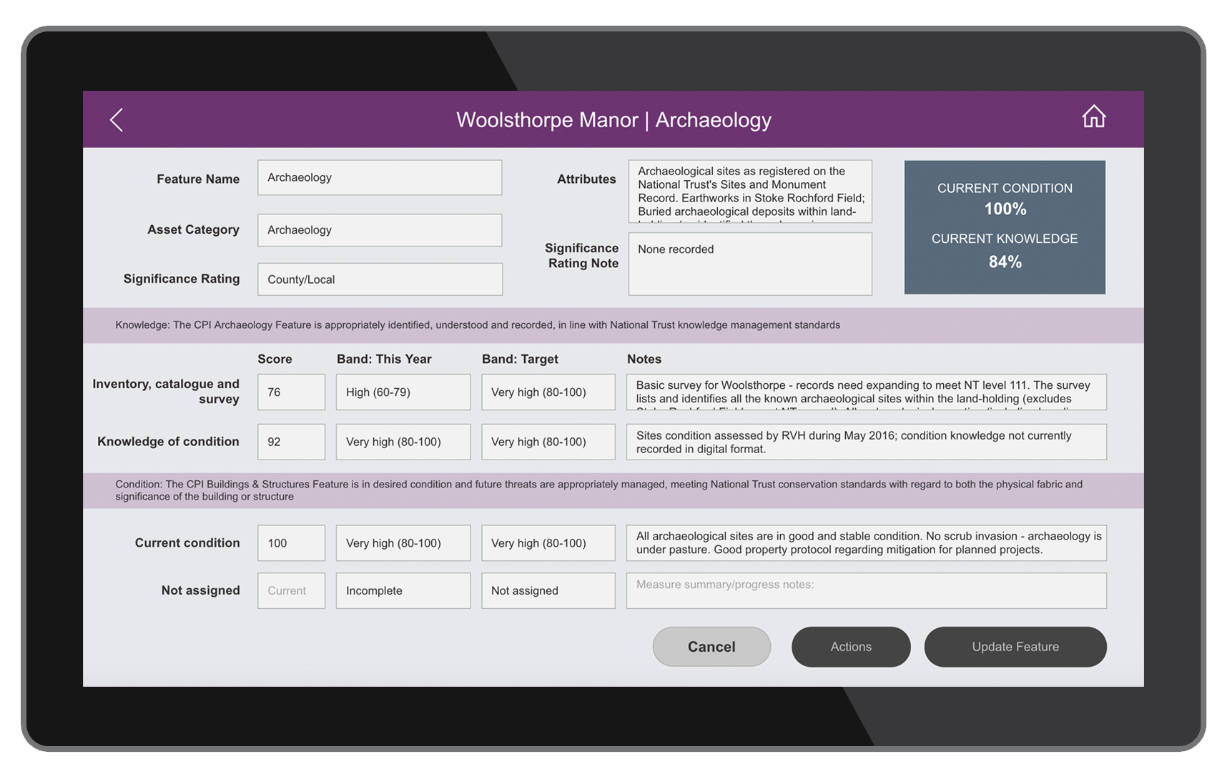
AFTER POWERAPPS
National Trust
National Trust partnered with eBECS to develop apps that help to improve their process.
The creation of the Admin Portal allows conservationist to define templates which ensures consistency in inspections.
The Inspection App allows volunteer inspectors to quickly submit inspection reports on-site using a tablet of their choice.

Slide 42
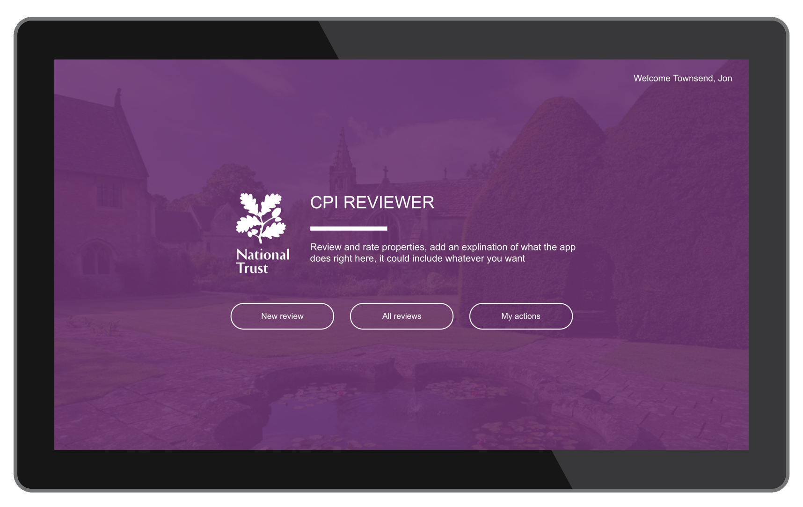
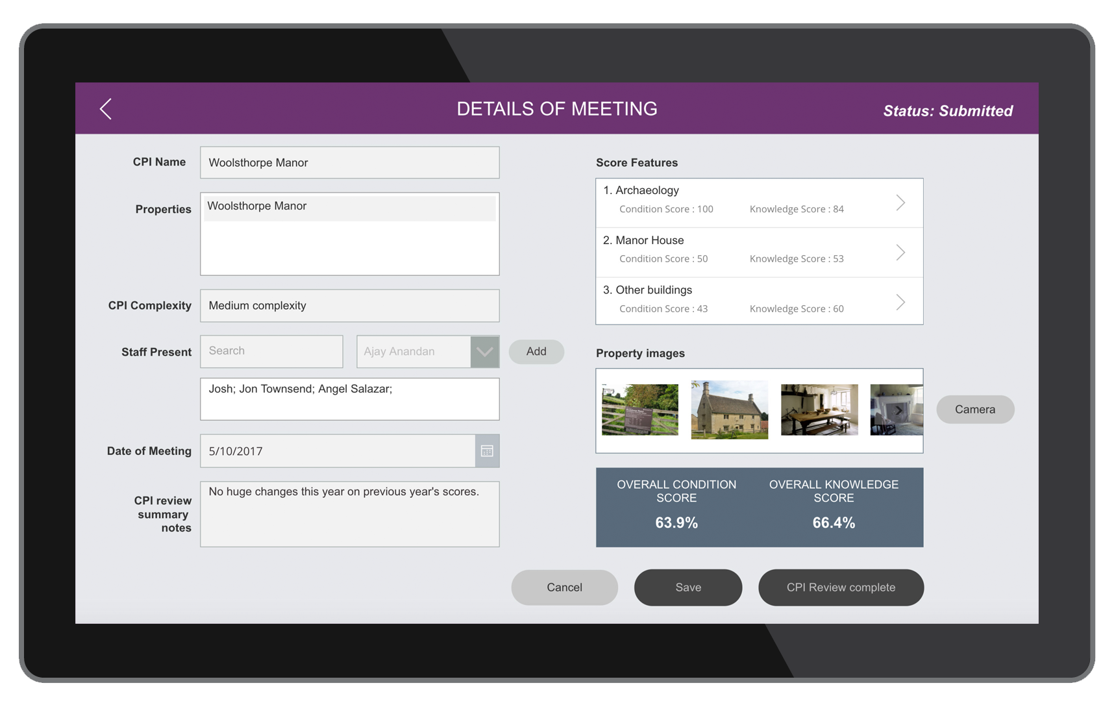
POWERAPPS SOLUTION
National Trust
Perform onsite inspections to add scores for various features of a property. Inspectors can also add and track follow up actions. An admin app is used to configure inspection templates per property.

Slide 43
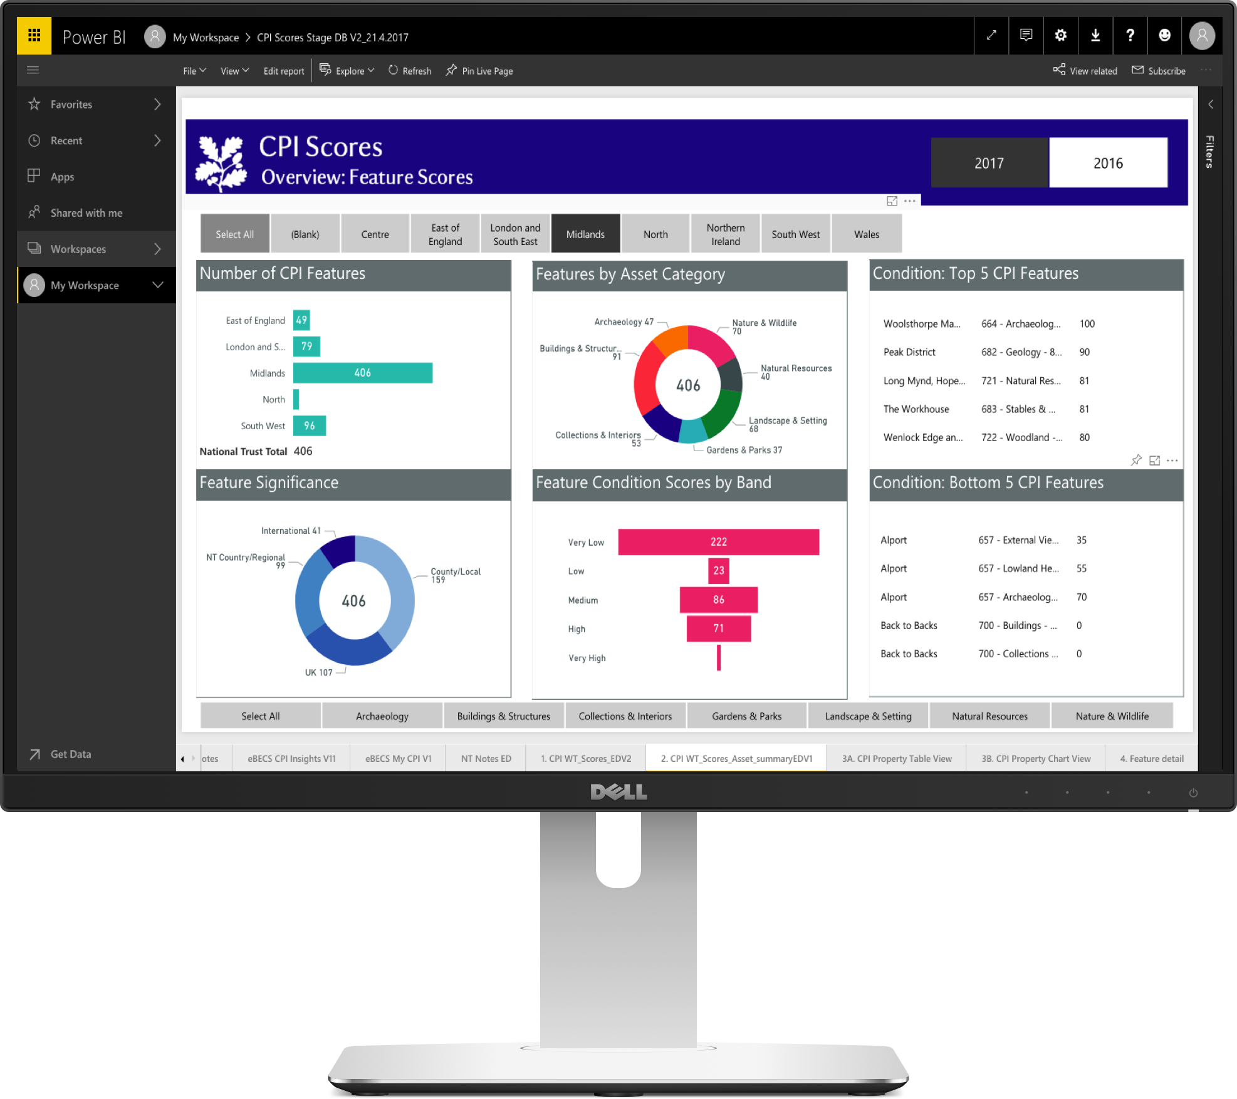
POWER BI
National Trust
PowerBI dashboards are used to view aggregated inspection results and drill into individual properties.
The dashboards help highlight which investments in improving the heritage properties, would provide the best return on investment.

Slide 44
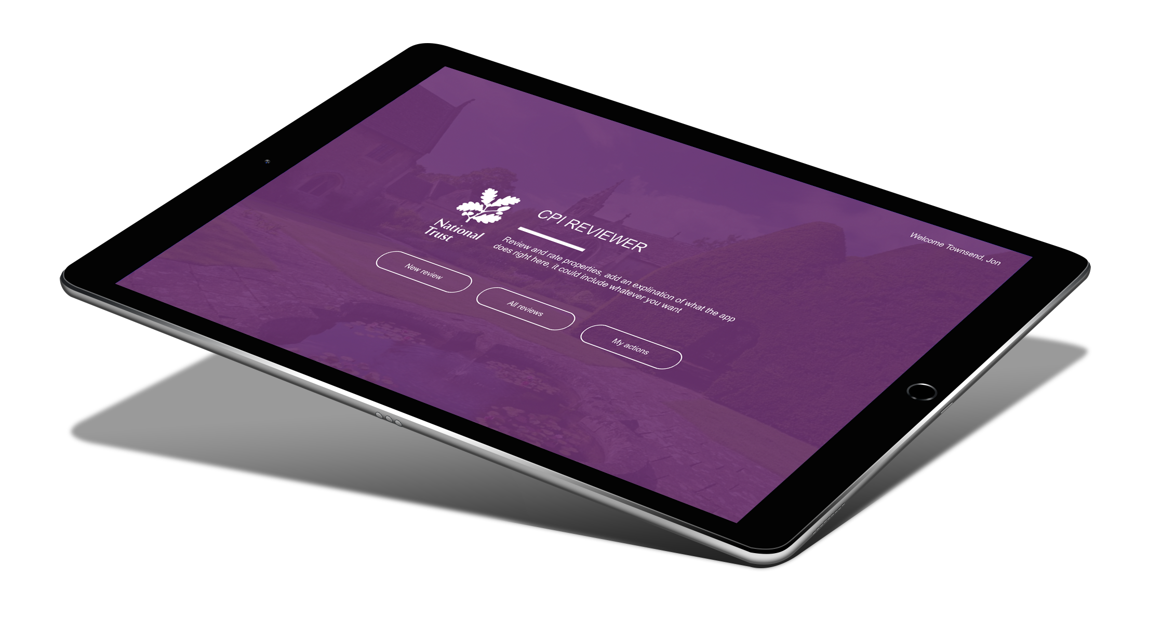
CUSTOMER QUOTES
National Trust
“PowerApps is simple to use, and integrates well with our existing Microsoft investments, making it very cost-effective. “
“The insights gained by using the PowerApps solution goes to the heart of what we’re trying to achieve at National Trust. “
Jon Townsend | Chief Information Officer, National Trust

Slide 45
Q & A

Slide 46
Resources to get started
2-minute introduction to PowerApps
http://powerapps.com and explore samples and templates
http://flow.microsoft.com and explore templates
Product overview and demos - 1-hour video
Build a device ordering app and approval flow – step-by-step lab (~3 hours)
Explore guided learning modules (2-10 minutes each): PowerApps | Flow
Browse documentation – PowerApps | Flow

Slide 47
Resources to learn more
See Microsoft Ignite 2017 on-demand sessions
Browse how-to videos in the PowerApps video gallery
Customer stories – video | case studies
Deep dive into formulas – videos | Formula reference
Get help from partners – showcase | partner directory

Slide 49
Appendix

Slide 50
Looking Ahead

Slide 51

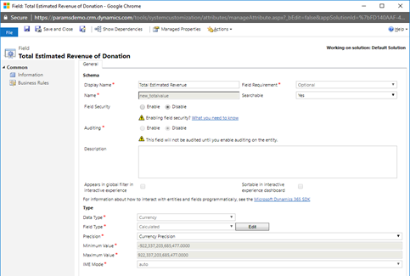

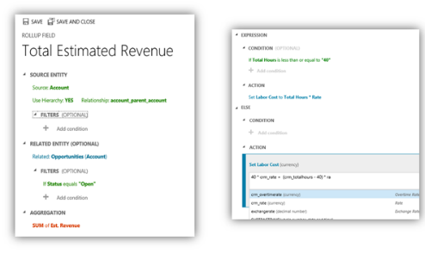
Looking ahead: Server-side logic support for PowerApps
Server-side logic bound to entities, works across all apps
Easily create validation and set field defaults
Update related entities with synchronous workflows
Notes:
We are also bringing more technolog to the PowerApps platform
To get us started, Server side logic will come PowerApps will come
hat means current customers can take advantage of validation rules and other logic that’s already in place in Dynamics 365, and net new creators can easily add these rules to their entities in CDS. I know there has been a lot of demand for this from the Access community and we are excited about adding this capability early next year.

Slide 52

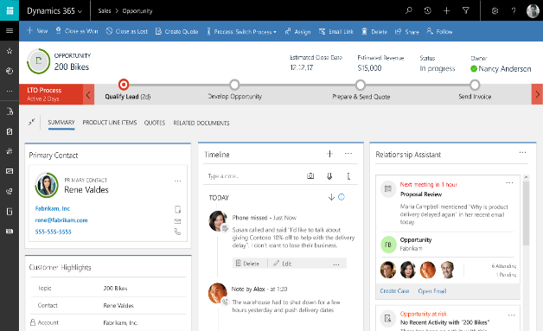
Looking ahead: Model-driven apps coming to PowerApps
A new style of app built from entities, forms and business processes
Form design auto adapts to customizations & extension for logic as well as visuals
Easily share forms, dashboards, flows, and more across multiple apps
Notes:
We’re also bringing a new way of building apps to PowerApps. We are excited to add the concept of model-driven apps to PowerApps.
The current type of applications you develop in PowerApps we will call canvas apps. In Canvas apps it is all about creating experiences for users screen by screen with complete control over what a user sees; great for task or role specific apps.
However, some apps really revolve more around entities, forms and business processes that orchestrate what users should see.
With model driven apps we now will provide this style of app creation in PowerApps, based on technology from Dynamics 365.

Slide 53
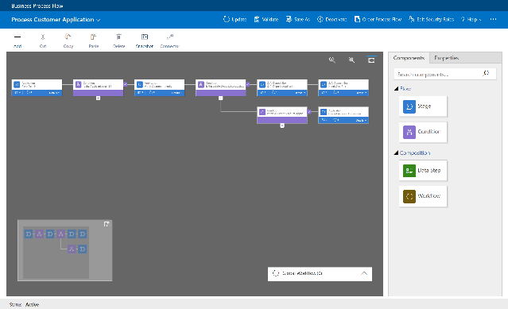
Looking ahead: Business Process Flow support in PowerApps
Visual indicators that tell users where they are in the business process
Reduce the need for training
Configurable to support common line of business methodologies
Pic of process flow explorer - Cathy
Notes:
One key capability used in Model driven apps are Business Process Flows. You will be able to visually define business processes that interact with your forms, making it super easy for users to follow a business process
The processes are centrally managed and so updating a business process will affect all users of that process.

Slide 54
PowerApps roadmap - highlights
H2 Calendar 2017
Calendar 2018
Create and use embedded PowerApps as custom list forms in SharePoint Online
Utilize attachments, multi-select fields, and images in your SharePoint Online driven PowerApps
Easily embed PowerApps in SharePoint Online pages with web parts and within Power BI reports
Use the Rules explorer for easier expression authoring
Tenant-wide admin resource management, app usage analytics, and package export/import across environments
Easily connect to Azure App Services & APIM
Use server-side business logic for validation rules and easy defaulting
Create model-driven apps
Support for GDPR compliance
Government cloud deployment
SQL - Support for stored procs and views
Enhanced application lifecycle management with sandbox environments
Roadmap is for general information purposes only and subject to change

Slide 55
Microsoft Flow roadmap - highlights
H2 Calendar 2017
Calendar 2018
Export/import Flows across environments
“In-the-box” review Flows for SharePoint Online
Use Flow for Content Publishing approvals for SharePoint Online Publishing sites
Utilize people, choice, attachment and multi-values in your Flows for SharePoint Online
In-context Flow support in Dynamics 365, OneDrive and Teams
Usage analytics for Flows
Flow activity included in Office 365 audit logs
UK deployment
Use a HTML rich text editor to build emails
Guides for debugging actions and conditions
Government cloud deployment
ALM – Sandbox environments
ALM – Move or copy across environments
Support for GDPR compliance
Leverage device signals (e.g. Location) with Flows on mobile devices
Include Flows in AppSource
Azure functions integration
Roadmap is for general information purposes only and subject to change

Slide 56
SharePoint  PowerApps & Flow
Notes:
One of the key places where those power users are implementing their business processes today is of course Sharepoint and so even further empowering those users has been a key focus for PowerApps and Flow
It has been exhilarating to see those communities embrace the possibilities we are adding

Slide 57

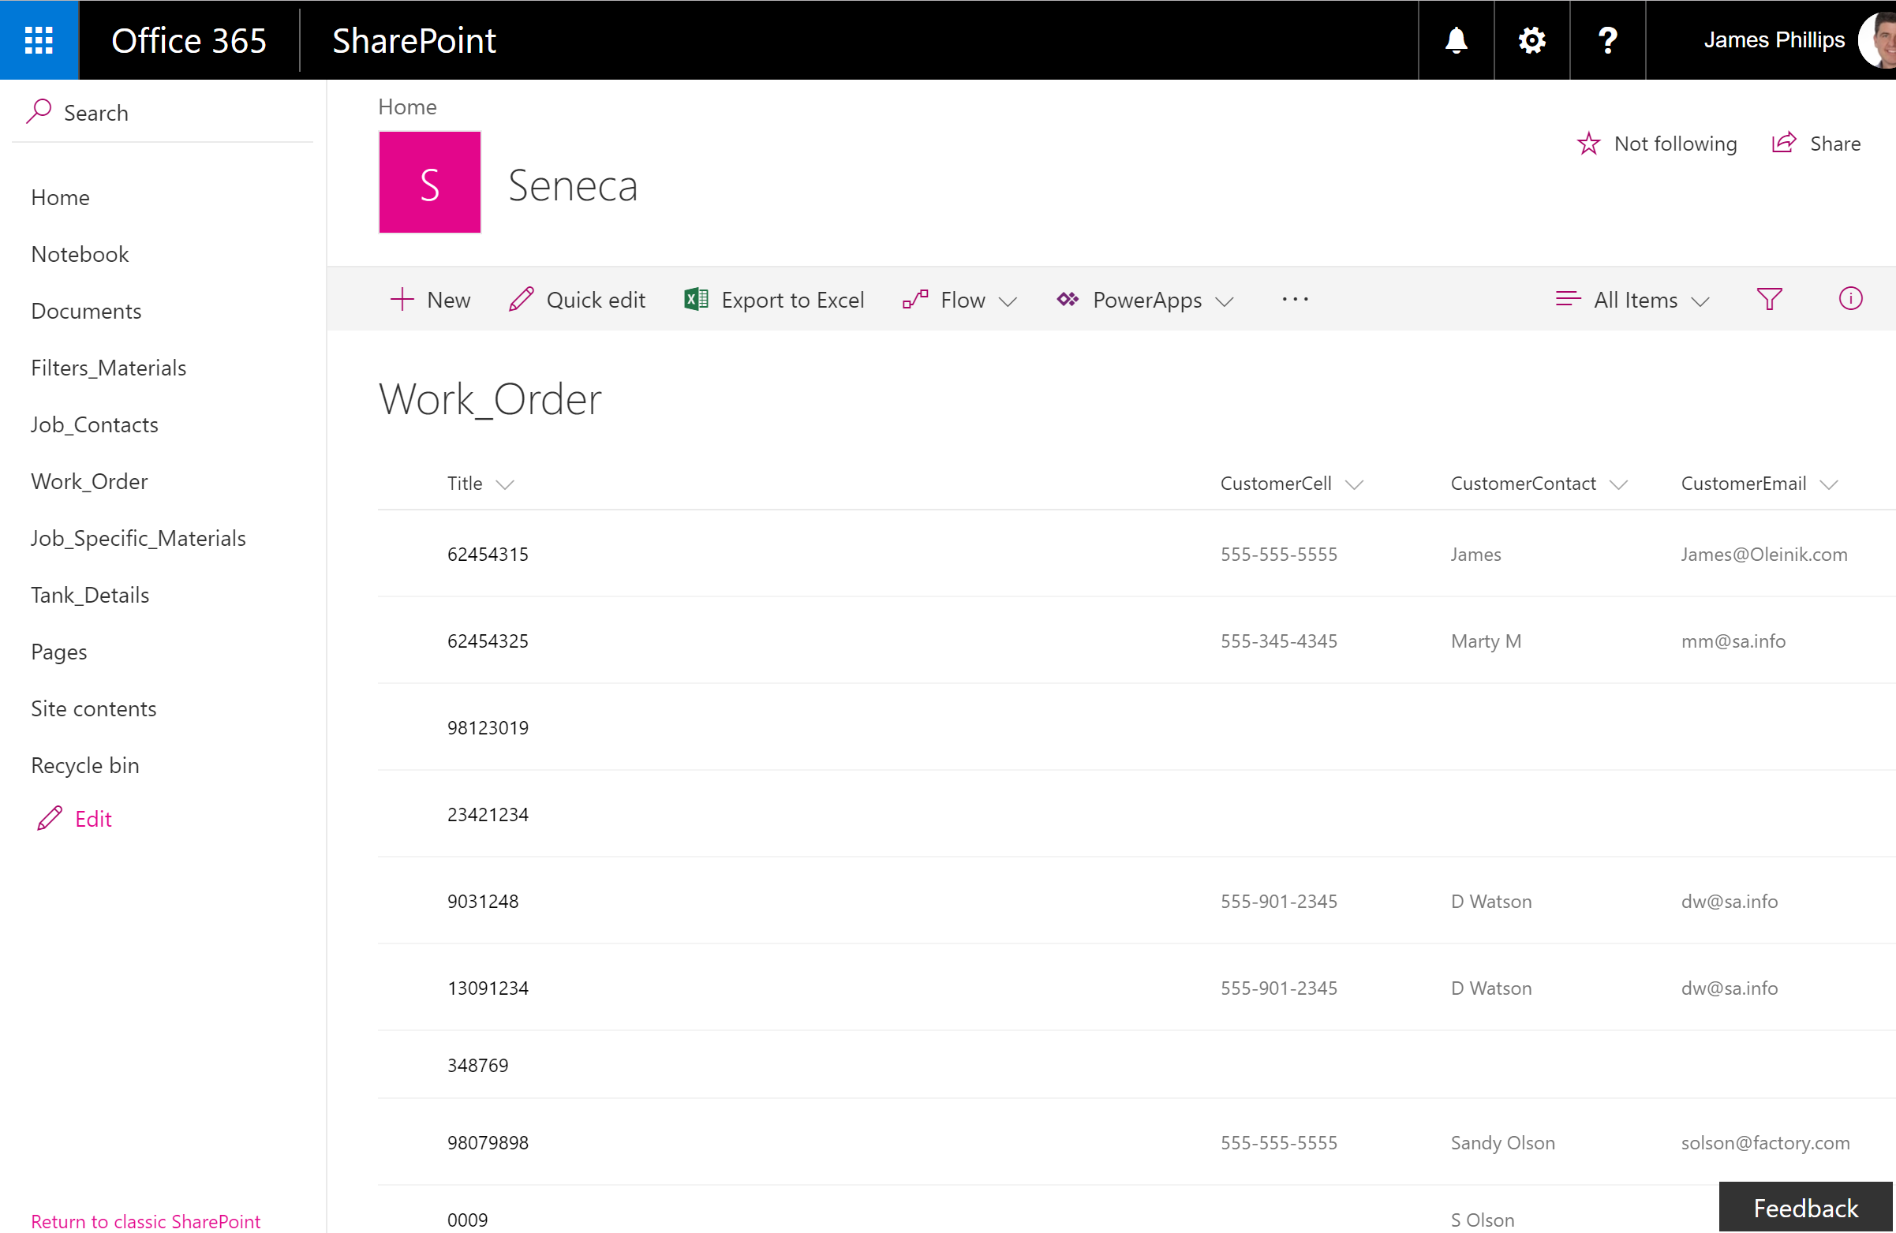
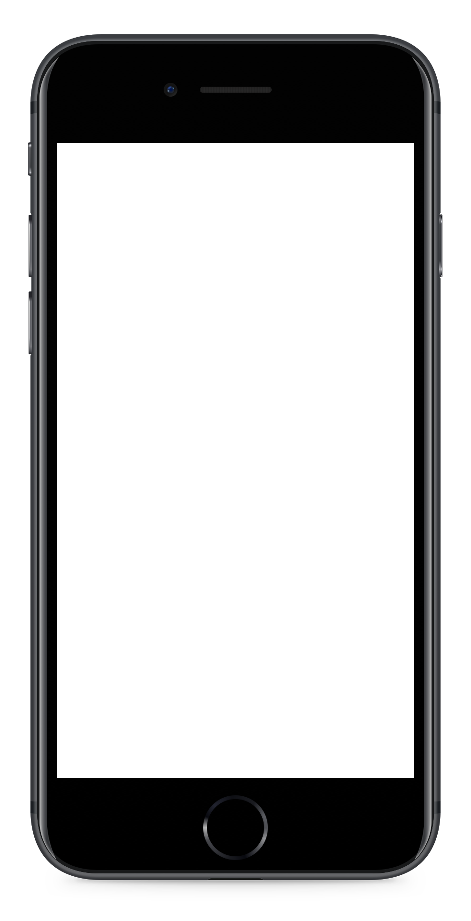
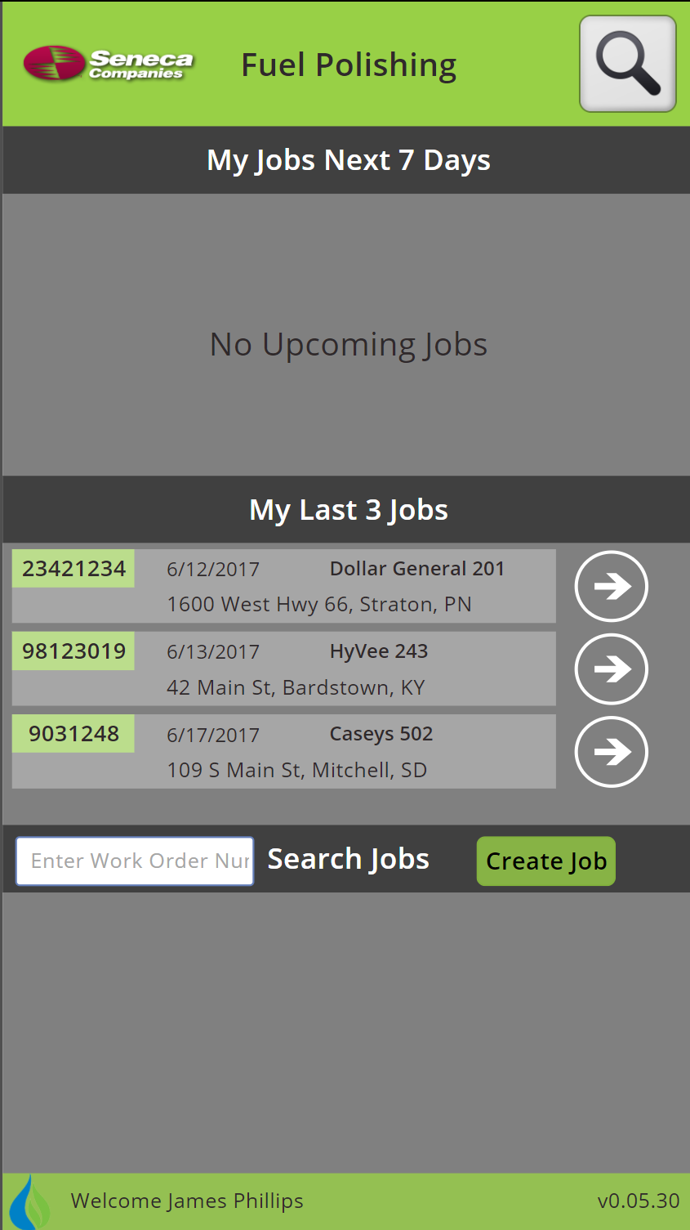
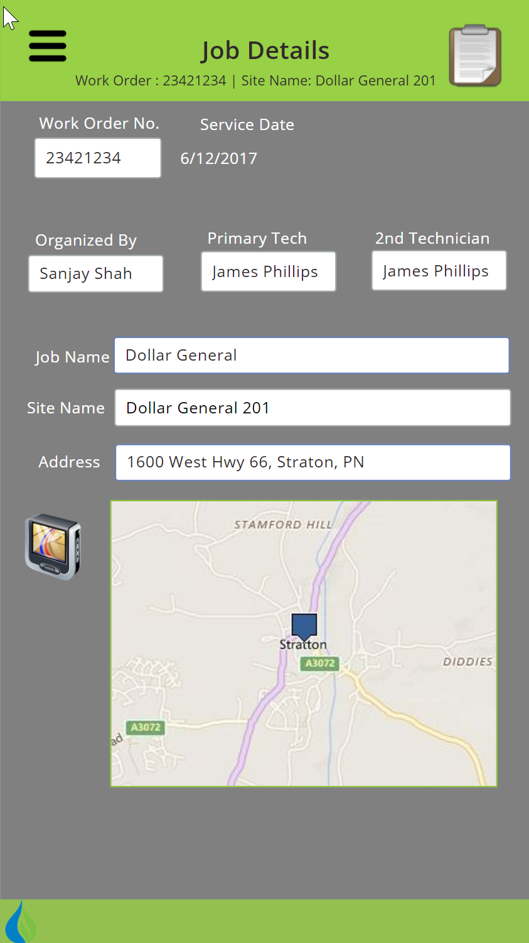
PowerApps & SharePoint
Empower users to build mobile apps from SharePoint data
Get started quickly with auto generated apps
Share apps easily and run them anywhere, mobile & web
Notes:
PowerApps today is already natively integrated directly into Sharepoints Modern List experience.
it will automatically generate a three screen mobile apps for that sharepoint list, you can share with your co workers as easily as an office document.
The app itself runs on all mobile platforms as well as the web.
As you heard in James Philips’ keynote companies like GJ Pepsi or Seneca are using those capabilities to build amazing mobile apps that really helped transform their business and directly integrate Sharepoint and office into processes that so far were manual and paper based. All from within the business and having the people who own the process able to refine the apps as the process gets refined.

Slide 58

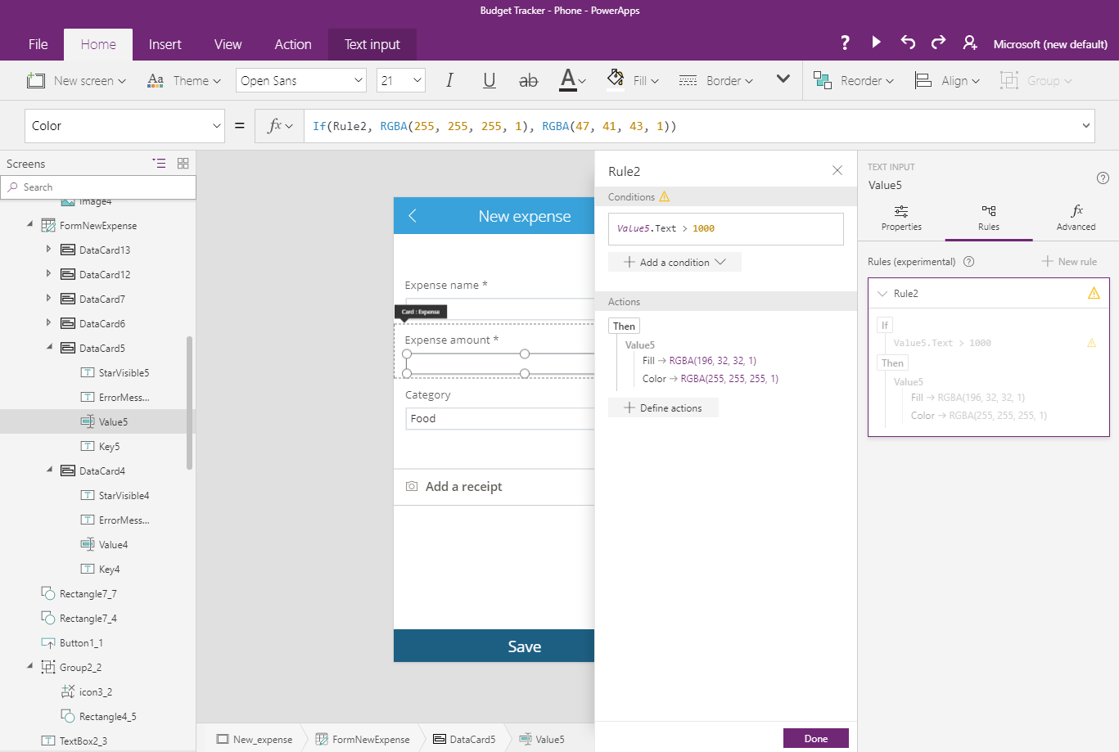
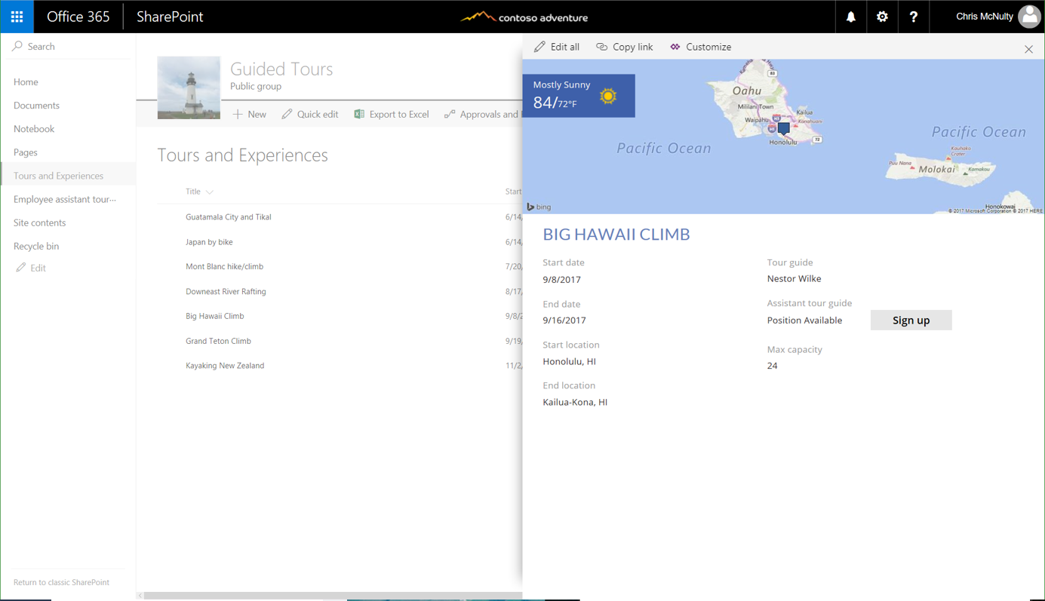
Now available: Custom forms for lists
Every list form is now customizable with PowerApps
Point-and-click rule builder for easy formatting and actions
Leverage over 160 apps and services directly in your list
Notes:
Excited to announce we are taking this now to the next level by bringing the power of POwerApps to Sharepoint embedded forms, launching in October.
So now you can use POwerApps to directly customize the forms that are displayed directly within your sharepoint list
You get the full Power of the platform, making it for example possible to also include external services and data sources directly into your sharepoint list. Need analytics integrated to look up relevant data on a list item? Just use the PowerBI integration PowerApps has to display the relevant PBI tiles!
As matter of fact you can connect to over 160 services through our connectors and use and relate that information directly to your sharepoint list, or use it to trigger actions like sending a SMS or creating entries in other systems. The possibilities are truly limitless, and all witout writing any code!
As the successor to Inforpath we also wanted to make sure that creation of forms has gotten even easier. So we have added a great point and click rule builder. Especially excited about the very intuitive way we have taken WYSIWYG to the next evel by letting you simply modify the form to the resulting state to allow rich visual changes to be simply clicked together. You’ll see that in the demo.

Slide 59
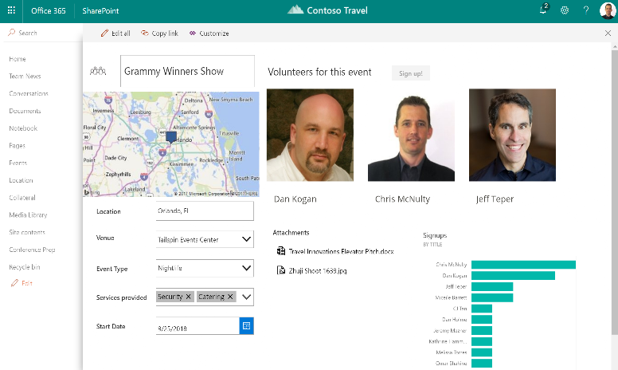
Custom forms with PowerApps
Available now
Built-in browser based customization experience
Integrated to modern SharePoint UX
Easy to customize, yet powerful enough to tackle complex scenarios

Slide 60
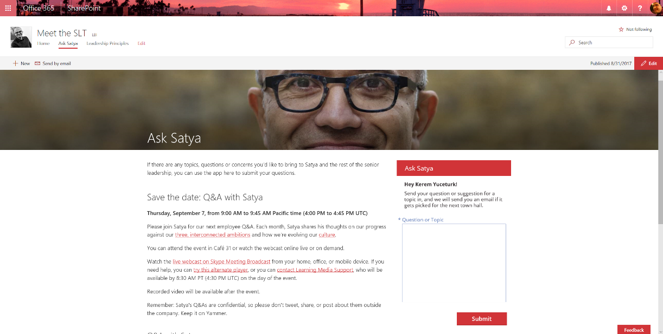
PowerApps web part
Q1 2018

Slide 61
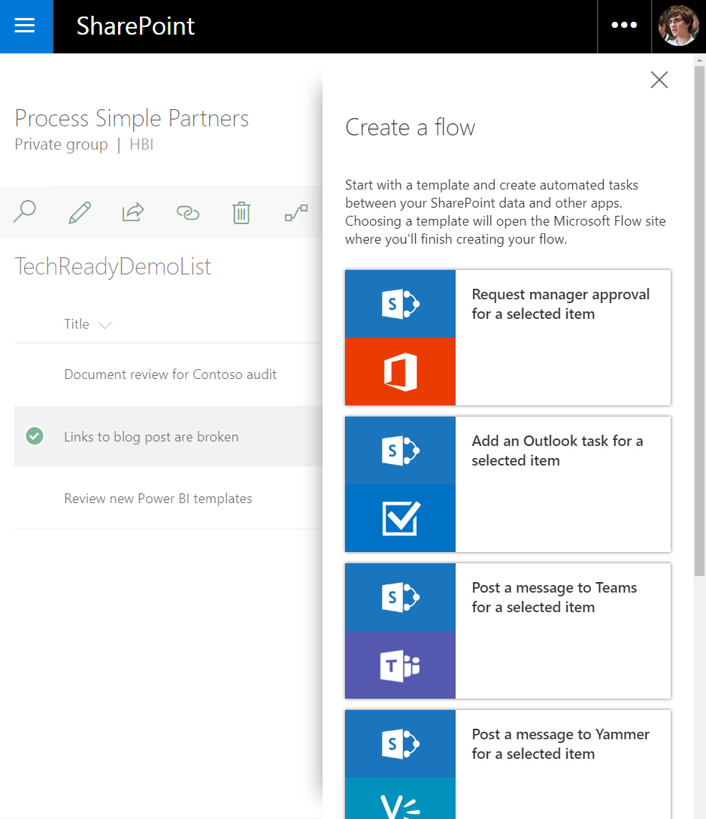
Microsoft Flow & SharePoint
Automate tasks with 100’s of pre-configured templates
Use Flow directly from SharePoint lists and libraries
Easily customize flows to fit your business processes
Notes:
Optimzing and transforming business processes isn’t of course only about building apps. Often its best to simply automate what needs to happen!
Flow is the workflow component of the business app platform and it is also directly integrated into Sharepoint, both Sharepoint lists and document libraries!
Out the box you have 100s of templates and it shows you a selection directly there in the list or library to automate common things. Want to post something in your Microsoft Teams channel every time a new item gets added to your sharepoint list capturing user feedback? No problem, there is a Flow for that!
BTW that also works of course equally the other way round and you can easily use a flow to add items to a sharepoint lists every time something happens in an external systems, thanks to those 160+ connectors we mentioned before. So want to have a SPO list that captures tweets that are postivei about your business? Just use a flow to look through tweets that mention your business and use cognitive services connector to look at the sentiment to decide whether its positive or negative and what to do.
I am constantly blown away by way creative ways makers are using Flow to customize their processes, if you haven’t seen Flow, the editor to customize flows is drag and drop visual and makes all of this super intuitive. You’ll see in the demo later.

Slide 62
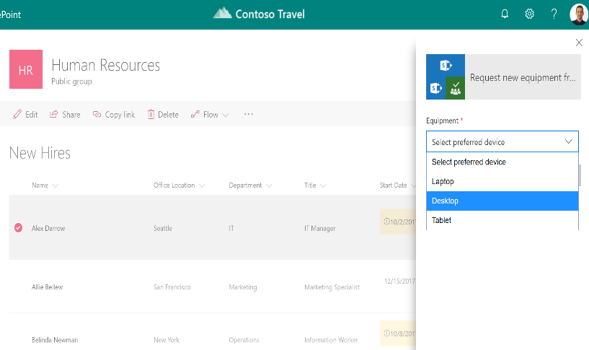
Flow launch panel
Available now
Create flows that prompt for information
Run as the user starting the flow
Integrated into modern lists and libraries in SharePoint

Slide 63

Content approval based on Microsoft Flow
Enhanced document library support with new one click approval
Trigger flows from OneDrive
Coming Soon
Content Approval flow integration
Notes:
And we are adding a lot more!
Approval are one of the most common type of business processes, so we further improved Flow approvals and from October they are now directly integrated into doc libraries and sharepoint lists as out of the box review flows. So you can trigger approvals directly from the library. Just enter who should approve it and they will get an approval email, to provide feedback and approve or decline.
We provide a central Flow approval center to easily see all approvals you have pending or approved. And BTW all of this info is stored in CDS!
IN addition the Power of Flow is also coming to OneDrive for Business, so you can also easily send that new doc you created for approval, even directly from the mobile OneDrive for business app.
Before the end of the year we will go one step further and Flow will support the Content Approval feature in Sharepoint, so you can use Flow to manage approvals before docs go live
And of course all the default out the box flows can be customized to directly fit YOUR business and your teams need!

Slide 64

Out of box “Send for review” flow
Q1 2018
Available in all lists and libraries, no set up required
Uses the Flow launch panel and prompts for approver and message
Tracks the status in a new column on the library: “Review status”

Slide 65
Use PowerApps & Flow
InfoPath/ SharePoint Designer
No new versions, supported through 2026
Access Web Apps
PowerApps/ Flow
Successors to InfoPath forms, Access Web Apps and SharePoint Designer workflows

Slide 66




Embed PowerApps in other apps
Teams
SharePoint
Power BI Report
Your app
PowerApps app as a tab
PowerApps app as a form or webpart
PowerApps app
PowerApps app in iframe

